Slide 1
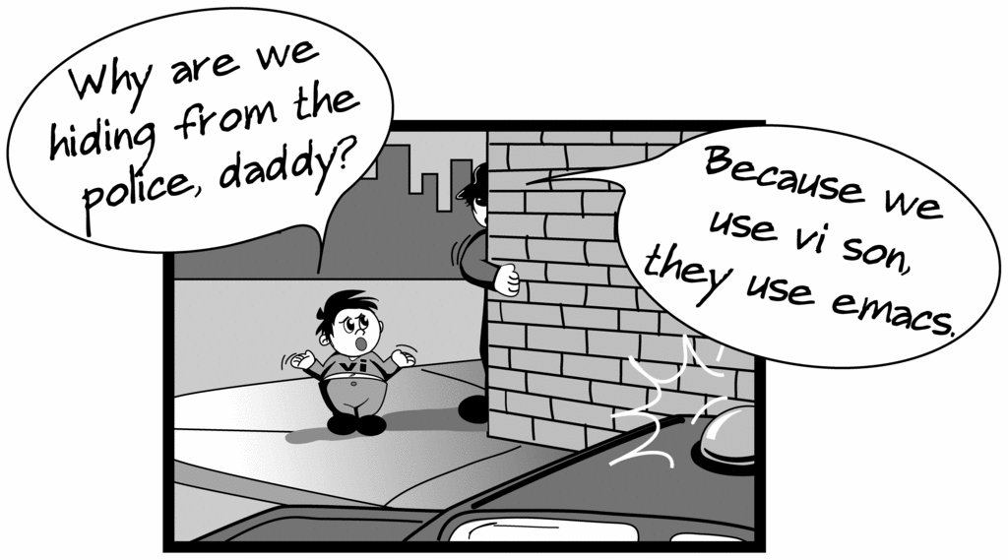
Creating files in Unix/Linux
Requires the use of an Editor
Various Editors:
nano / pico
vi
emacs

Slide 2
Vi editor
The VI editor is the most popular and classic text editor in the Linux family.
Below, are some reasons which make it a widely used editor –
1) available in almost all Linux Distributions
2) works the same across different platforms and Distributions
3) user-friendly.

Slide 3
Modes of Vi editor
Command Mode
Insert Mode
Escape Mode

Slide 4
Modes of Vi editor
Command Mode - vi starts in Command Mode.
vi interprets any characters we type as commands and does not display them in the window.
This mode allows us to move through a file, and to delete, copy, or paste a piece of text. To enter into Command Mode from any other mode, it requires pressing the [Esc] key. If we press [Esc] when we are already in Command Mode, then vi will beep or flash the screen.

Slide 5
Insert Mode - enables you to insert text into the file. –
-Everything that’s typed in this mode is interpreted as input and finally, it is put in the file.
-The vi always starts in command mode. To enter text, you must be in insert mode. To come in insert mode you simply type i. To get out of insert mode, press the Esc key, which will put you back into command mode.

Slide 6
Escape Mode
- enables you to perform tasks such as saving files, executing commands.
-invoked by typing a colon [:], while vi is in Command Mode.
-The cursor will jump to the last line of the screen and vi will wait for a command.

Slide 7
vi editing commands
i - Insert at cursor (goes into insert mode)
a - Write after cursor (goes into insert mode)
A - Write at the end of line (goes into insert mode)
ESC - Terminate insert mode
U - Undo all changes to the entire line
o - Open a new line (goes into insert mode)
dd - Delete line
3dd - Delete 3 lines.

Slide 8
D - Delete contents of line after the cursor
dw - Delete word
4dw - Delete 4 words
cw - Change word
x - Delete character at the cursor
r - Replace character
R - Overwrite characters from cursor onward

Slide 9
s - Substitute one character under cursor continue to insert
S - Substitute entire line and begin to insert at the beginning of the line
Make sure you press the right command otherwise you will end up making undesirable changes to the file.
You can also enter the insert mode by pressing a, A, o,

Slide 10
Moving within file
k - Move cursor up
j - Move cursor down
h - Move cursor left
l - Move cursor right

Slide 11
Saving and closing file
:w - Save the file but keep it open
:q - Quit without saving
:wq - Save the file and quit

Slide 12
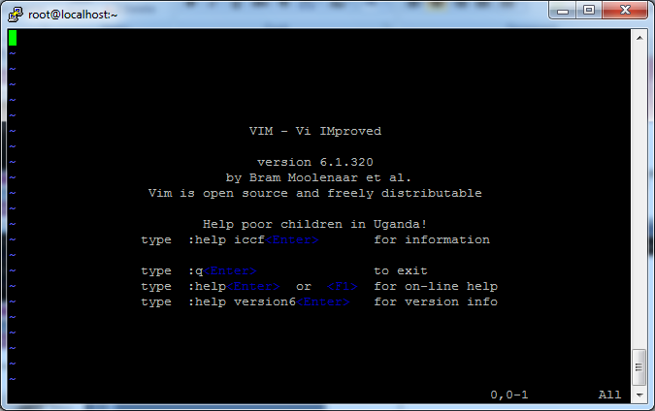
Editing a file using vi
Type “vi” at the prompt

Slide 13
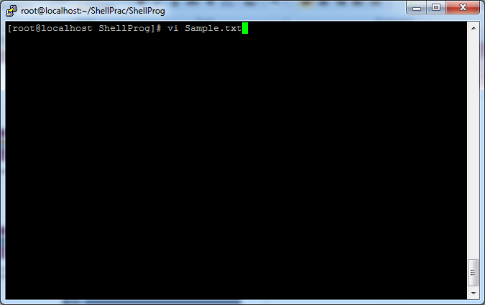
Create a file using vi
Type vi Sample.txt

Slide 14
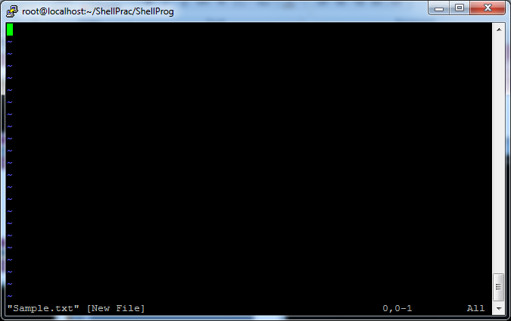
Create a file using vi
After Typing vi Sample.txt, File Created

Slide 15
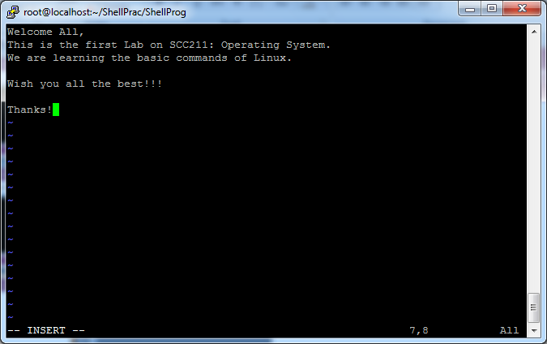
Insert text in a file using vi
To insert: Esc+ i

Slide 16
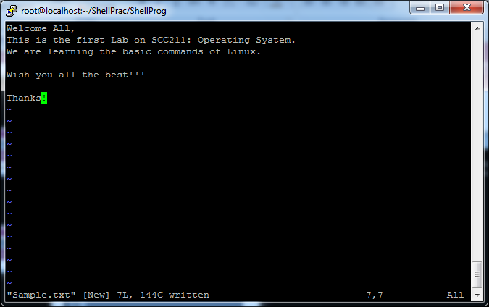
Insert text in a file using vi
To Save File: Esc+ : + w

Slide 17
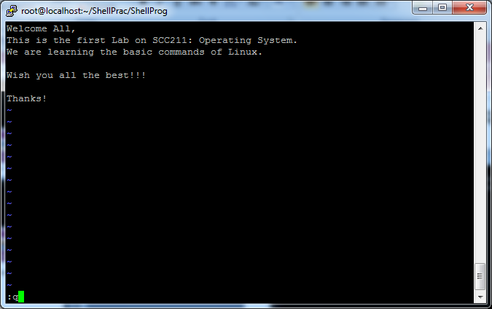
Insert text in a file using vi
To Quit File: Esc+ : + q

Slide 18
Displaying a file
Various ways to display a file in Unix
cat
less
head
tail

Slide 19
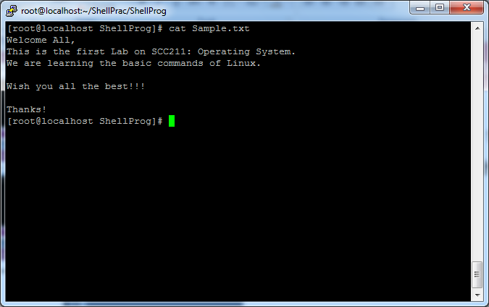
Command: cat
Dumps an entire file to standard output
Good for displaying short, simple files

Slide 20
WC Command
Used for printing newline, word and byte counts for files.
It can return the number of lines in a file, the number of characters in a file and the number of words in a file.
The output is number of lines, number of words, number of bytes, filename.

Slide 21
Options
-l To print the number of lines in a file .
-m To print the number of characters in a file .
-w To print the number of words in a file .

Slide 22
cmp
used to compare the two files byte by byte .
helps you to find out whether the two files are identical or not.
reports the location of the first mismatch to the screen if difference is found and if no difference is found i.e the files compared are identical.
displays no message and simply returns the prompt if the files compared are identical.

Slide 23
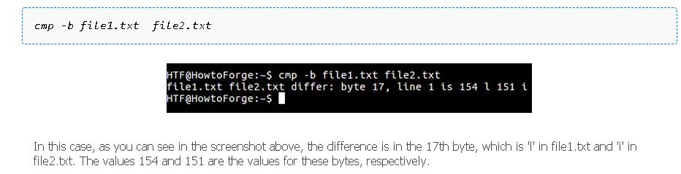
'cmp' display the differing bytes in its output.
cmp -b [file1] [file2]

Slide 24
-i [bytes-to-be-skipped] : Now, this option when used with cmp command helps to skip a particular number of initial bytes from both the files and then after skipping it compares the files.
cmp –i 5 file1 file2
-i [bytes to be skipped from first file] : [bytes to be skipped from second file] :This option is very much similar to the above -i [bytes to be skipped] option but with the difference that now it allows us to input the number of bytes we want to skip from both the files separately.
Cmp –i 4:4 file1 file2

Slide 25
-n [number of bytes to be compared] option :This option allows you to limit the number of bytes you want to compare ,like if there is only need to compare at most 25 or 50 bytes.

Slide 26
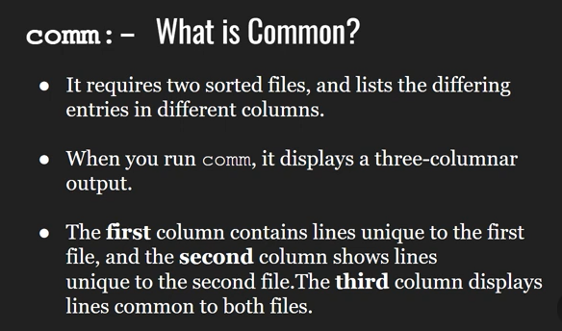

Slide 27
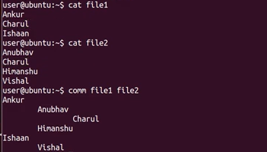

Slide 28
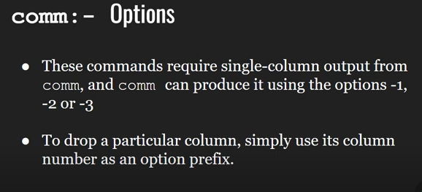

Slide 29
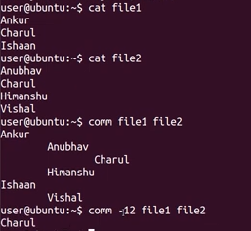

Slide 30
sort
sort lines alphabetically by default.
Running sort filename writes the contents of the filename in alphabetical order to standard output.
-r sort in reverse order and write the result to standard output.
-n This will sort from lowest number to highest number and write the result to standard output.
Suppose a file exists with a list of items of clothing that has a number at the start of the line and needs to be sorted numerically.

Slide 31
How to sort and remove duplicates
To sort and remove duplicates pass the -u option to sort. This will write a sorted list to standard output and remove duplicates.

Slide 32
To sort by month pass the -M option to sort

